Slide 1
Microsoft Teams Developer
Authentication

Slide 2

Authentication in Tabs
AAD Tab authentication
Silent Authentication and SSO
DEMO

Slide 3
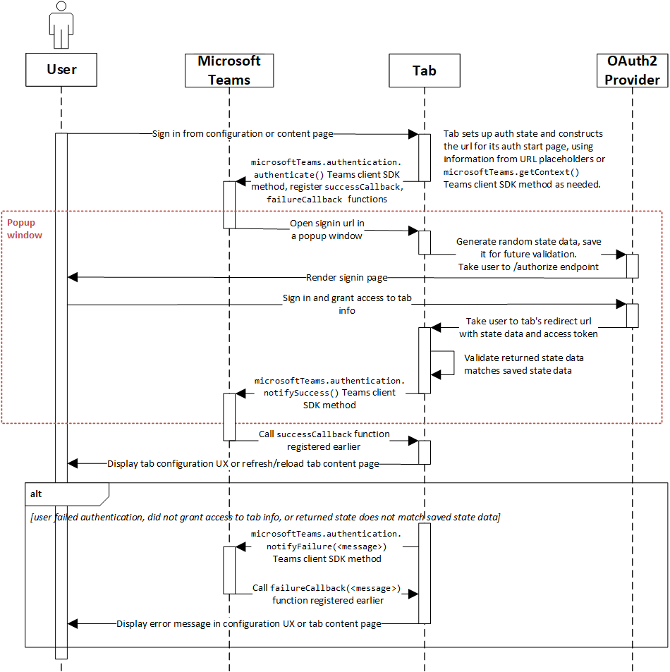
Authentication Flow for tabs
Notes:
The canonical authentication graphic. Highlight the Popup Window section, which is opened/closed by Teams, not the developer

Slide 4
Authentication in Tabs
Authenticating
Authentication cannot occur in IFRAME
Teams JavaScript library facilitates popup and cross-window communication microsoftTeams.authentication.authenticate({ url: <auth URL>, width: <width>, height: <height>, successCallback: <successCallback>, failureCallback: <failureCallback>})
In <auth URL> signal result and pass data microsoftTeams.authentication.notifySuccess(token) microsoftTeams.authentication.notifyFailure(err)
Tabs can only show pages in validDomains list of manifest
Configure Identity Provider
An application registration (separate from the bot registration) is likely required
Configure app for AAD v1 or AAD v2 as appropriate
Any OAuth provider is supported

Slide 5
Silent Authentication and SSO
Silent authentication in Azure Active Directory (AAD) is a simplified form of single sign-on (SSO). Its purpose it to minimize the number of times a user needs to enter login credentials while using your app.
Include and configure ADAL
Get User Context
Authenticate
Process return value
Notes:
Microsoft Teams Authentication Sample: https://github.com/OfficeDev/microsoft-teams-sample-complete-node

Slide 6
Silent Authentication and SSO - Authenticate
let authContext = new AuthenticationContext(config); // from ADAL.js
// See if there's a cached user and it matches the expected user
let user = authContext.getCachedUser();
if (user) {
if (user.profile.oid !== userObjectId) {
authContext.clearCache();
}
}
let token = authContext.getCachedToken(config.clientId);
if (token) {
showProfileInformation(token);
} else {
// No token, or token is expired
authContext._renewIdToken(function (err, idToken) {
if (err) {
console.log("Renewal failed: " + err);
// Failed to get the token silently; show the login button
showLoginButton();
} else {
showProfileInformation(idToken);
}
});
}
If ADAL has an unexpired token cached for the user, use that. Otherwise, attempt to get a token silently.
Call _renewIdToken or _renewToken as appropriate
Notes:
Microsoft Teams Authentication Sample:https://github.com/OfficeDev/microsoft-teams-sample-auth-node
RenewIdToken for user id token
RenewToken for AAD token for specified resource (MSGraph)

Slide 7
Demo Add authentication to a Tab

Slide 8

Summary
AAD Tab authentication
Silent Authentication and SSO

Slide 9
Thank you

